Slide 1
ANGLE BETWEEN TWO INTERSECTING LINES
Prepared by:
Prof. Teresita P. Liwanag – Zapanta
B.S.C.E., M.S.C.M., M.Ed. (Math-units), PhD-TM (on-going)

Slide 2
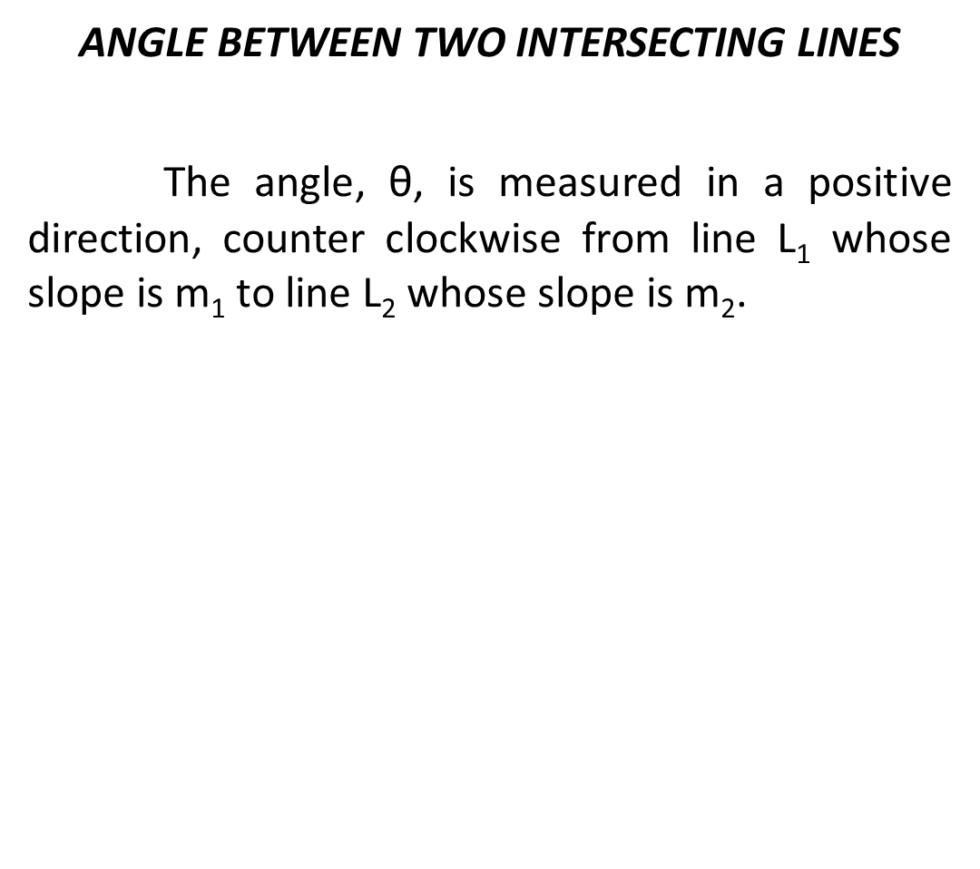








y

Slide 3
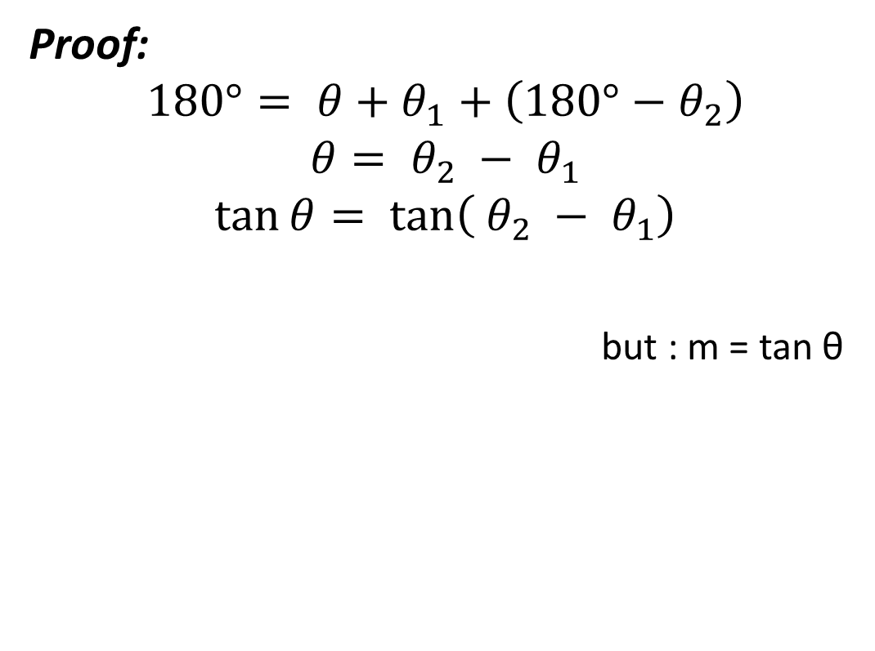




Slide 4
Examples:
The line through the points (-1, 6) and (5, -2) intersects the line through (4, -4) and (1,7). Determine the angle between these two intersecting lines.
The angle from the line through (x, -1) and (-3, -5) to the line through (2, -5) and (4, 1) is 45 . Find x.
Two lines passing through (2, 3) make an angle of 45 . If the slope of one of the lines is 2, find the slope of the other.
Find the interior angles of the triangle whose vertices are A (-3, -2), B (2, 5) and C (4,2).

